Slide 1
Water, Water, Water Everywhere but Not a Drop to Drink:
Hydraulic Fracturing for Natural Gas – the “Clean” Energy
By: Helen Schaaf

Slide 2
Stance
Hydraulic Fracturing, or “Fracking,” should not be used as a way to obtain Natural Gas.

Slide 3
History
1000 B.C. – In Greece, before the understanding of Natural Gas, reported cases of lightning would sometimes strike the Earth and would ignite the escaping Natural Gas.
500 B.C.- The Chinese discovered a potential for the fires, and formed pipeline out of bamboo to transport the Natural Gas.
1785- Britain is the first country to commercialize the use of Natural Gas.
1816- Natural Gas produced for coal, rather than naturally occurring was brought to the United States
1938- Natural Gas was first regulated by the United States Government

Slide 4
History
1970- early 1990- A number of gas shortages and price irregularities indicated that regulated market was not best for the consumer
2005- Energy Policy of 2005
2008 - Reports of the consequences from “fracking” come to light when a home video is released.
2010 – Natural Gas Companies used the down turn of the economy to recruit workers.
2010 – “Gasland” the documentary is released
March 2010 – EPA has the first hearings on the possibility of human health and environmental effects.

Slide 5
Energy Policy of 2005
Halliburton Loop-hole:
SEC. 322. HYDRAULIC FRACTURING.
Paragraph (1) of section 1421(d) of the Safe Drinking Water
Act (42 U.S.C. 300h(d)) is amended to read as follows:
‘‘(1) UNDERGROUND INJECTION.—The term ‘underground
injection’—
‘‘(A) means the subsurface emplacement of fluids by
well injection; and
‘‘(B) excludes—
‘‘(i) the underground injection of natural gas for
purposes of storage; and
‘‘(ii) the underground injection of fluids or propping
agents (other than diesel fuels) pursuant to hydraulic
fracturing operations related to oil, gas, or geothermal
production activities.’’.
http://gaslandthemovie.com/

Slide 6
Hydraulic Fracturing
Process
http://news.nationalgeographic.com/news/2010/10/101022-breaking-fuel-from-the-rock/

Slide 7
Aquifers

Slide 8
Infected Waters
Flow back Water:
- Approximately 400 to 600 truck loads of fracturing fluid laced water with sand and other materials is pumped down the well hole.
- Approximately 200 to 300 trucks of that same water comes back up out of the whole.
http://gaslandthemovie.com/

Slide 9
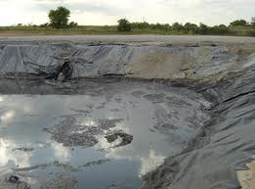
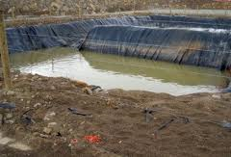
Unmarked Waste Pits
This water is seeping back into the ground contaminating water supply

Slide 10
Fracking Fluid
List of chemicals contained with one sample of fracturing fluid
Other samples known on have over 596 chemicals
Over 944 chemical products are formed as a result of the “fracking” process.

Slide 11
Fracking Fluid Continued
Health effects of the 362 chemicals break out as follows:
Percentage Number
62% 225 skin and sensroy organ toxicant
60% 216 respiratory toxicants
46% 167 gastrointestinal and liver toxicants
32% 115 neurotoxicants
27% 98 cardiovascular and blood toxicants
27% 98 kidney toxicants
25% 91 immunotoxicants
22% 80 wildlife toxicants
21% 75 reproductive toxicants
20% 74 carcinogens
19% 68 developmental toxicants
16% 59 result in other disorders
13% 48 endocrine disruptors
12% 45 mutagens

Slide 12
Fracking Fluid Continued
The 72 (20%) chemicals on the list that can vaporize break out as follows:
Percentage Number
83% 60 skin and sensroy organ toxicant
78% 56 respiratory toxicants
75% 54 gastrointestinal and liver toxicants
65% 47 neurotoxicants
56% 40 cardiovascular and blood toxicants
56% 40 kidney toxicants
46% 33 developmental toxicants
43% 31 reproductive toxicants
38% 27 wildlife toxicants
33% 24 immunotoxicants
32% 23 carcinogens
25% 18 result in other disorders
22% 16 endocrine disruptors
21% 15 mutagens

Slide 13
Fracturing Fluid Continued
The 116 (32%) chemicals on the list that are soluble or miscible in water break out as follows:
Percentage Number
89% 103 skin and sensroy organ toxicant
81% 94 respiratory toxicants
69% 80 gastrointestinal and liver toxicants
45% 52 neurotoxicants
44% 51 cardiovascular and blood toxicants
40% 46 kidney toxicants
39% 45 immunotoxicants
35% 41 wildlife toxicants
32% 37 result in other disorders

Slide 14
Endocrine Disruption
Endocrine Driven Disorders
- ADHD
Autism
Diabetes
Obesity
Early Onset Testicular Cancer
Endometriosis
http://www.democracynow.org/2010/4/14/world_renowned_scientist_dr_theo_colborn

Slide 15
Split Estate
Is the process where the government leases the land from the homeowner, to build Natural Gas Drilling Sites
The Homeowner owns the surface land
The Government owns the mineral rights, and resources underneath the surface.
http://www.splitestate.com/video_clips.html

Slide 16
Environmental Impacts
Because 4-6 acres are cleared for each drilling site, animal or loosing their homes.
Due to open/ unmarked waste water pits, animals are drinking the water and getting very sick or dying as a result.
The Ground water is being polluted.

Slide 17
Push for Natural Gas
“Saudi Arabia” for Natural Gas
United States would contain their own fuel supply
Increase in the Job market
Because Natural Gas burns cleaner than coal, it would lower the effect on green house emissions into the atmosphere.

Slide 18




Painting a Pretty Picture

Slide 19
Cornell’s Study
Cornell Study finds natural gas no better than coal
Even though Natural Gas burns cleaner than coal, it takes a lot more energy and man-power to complete the Hydraulic Fracturing process.

Slide 20
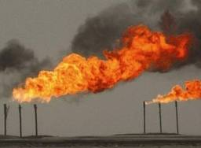

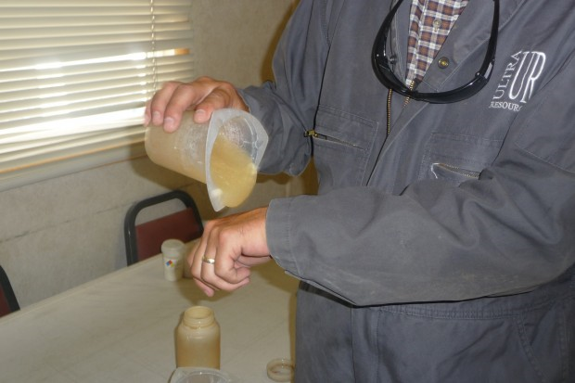
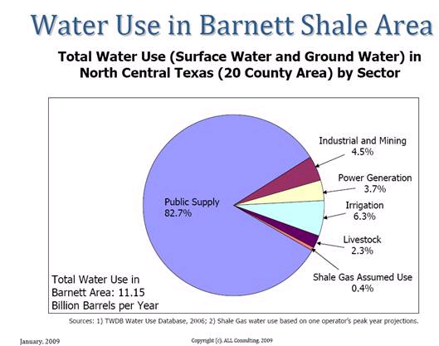
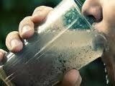
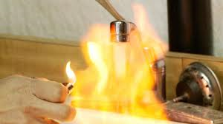
Reality

Slide 21
Future
As of January 2010, Natural Gas Drilling companies have proposed over five-hundred drilling sites along the Delaware River in Pennsylvania.
If passed the drinking water will be effected of those in Pennsylvania, New York, New Jersey, and Delaware.
The EPA is now doing research to invaliadate/ validate if there are actual health risks and environmental effects associated with “fracking”
Each area can fight and sign petitions to stop drilling in their state.

Slide 22
Resources
http://doi.net/iepa/EnergyPolicyActof2005.pdf
http://news.nationalgeographic.com/news/2010/10/101022-breaking-fuel-from-the-rock/
http://gaslandthemovie.com/
Bachran, Mary. ANALYSIS OF CHEMICALS USED IN NATURAL GAS & OIL DEVELOPMENT AND DELIVERY: FOUR WESTERN UNITED STATES. 28 March 2007.
http://www.endocrinedisruption.com/files/chemicals_used_in_oil_and_natural_gas_development_four_western_states.pdf. 28 February 2001.

Slide 23
Resources
Fisher, Kevin. Data Confirm Safety of Well Fracturing. The American Oil & Gas Reporter. July 2010.
http://www.fidelityepco.com/Documents/OilGasRept_072010.pdf. 28 February 2011.
Marcellus Drilling News. List of 78 Chemicals Used in Hydraulic Fracturing Fluid in Pennsylvania. 10 June 2010. Corpvox WordPress Theme. http://marcellusdrilling.com/2010/06/list-of-78- chemicals-used-in-hydraulic-fracturing-fluid-in- pennsylvania/. 2 March 2011.

